Slide 1
Network programming for the cloud ERA
Ratul Mahajan

Slide 2
Microsoft Azure network expanded 100x in 5 years
 | 2010 | 2015
Data centers | O(1) | O(100)
Network devices | O(1,000) | O(100,000)
Network capacity | O(10 Tbps) | O(1 Pbps)
Notes:
Compare with: Internet traffic grew 6x during this time period.

Slide 3
Cloud has become the dominant computing paradigm
Notes:
Cloud computing: using a network of remote servers rather than a local server or a PC.
The word has permeated into the popular culture and big banners advertising the cloud welcome you in sea tac.
Many of your favorite applications are made possible through the power of cloud.

Slide 4
Traditional workloads are also being cloudified
Notes:
Many traditional workloads are being cloud-ified as well.
This broad transformation is transforming all aspects of the computing stack.
Exciting time to be a computer science researcher especially a networking researcher.
The network is central to this transformation, which is why you see that 100x growth.

Slide 5
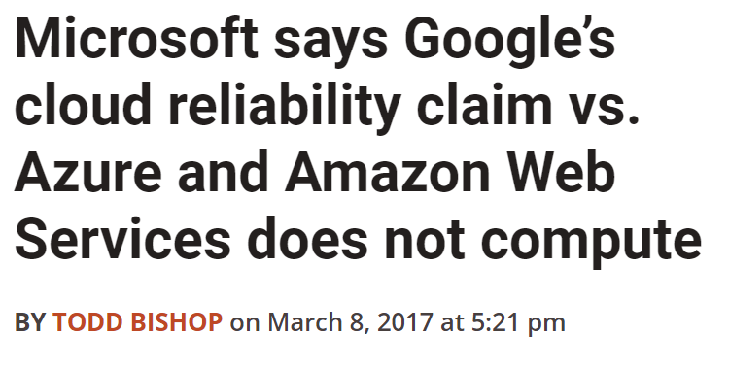
How are cloud networks different?
An extreme focus on ERA
Efficiency
Reliability
Agility
Gbps / $
$$1\% of ∞=∞$$
Notes:
Key question: Building something different or just more of the same?
If I distill what I hear from network architects and engineers, they want to build different types of networks. The differences can be summed by an extreme focus on ERA.
Efficiency: Because of scale. Shaving 1% of infinity means that you save an infinite
Reliability: Which customers and workloads you get are directly dependent on that.
Agility: Needs of applications are continuously evolving. Must be able to evolve infrastructure quickly.
It is not that ERA was not important before but the degree to which it matters now is different. Leads to different challenges and calls for different solutions.
The goals can be at odds with each other.

Slide 6
Cloud network ERA today
Poor efficiency: Average network utilization is well below 50%
1
0.8
0.6
0.4
0.2
0
Average utilization = 46%
Normalized throughput
0 | 4 | 8 | 12 | 16 | 20 | 24
Hours of the day
Normalized traffic on a busy link between data centers
Notes:
Low utilization means poor efficiency. It is like being able to enjoy only half of the expensive penthouse you bought.
Later on, I’ll get into why efficiency is low here and what we can do about it.

Slide 7
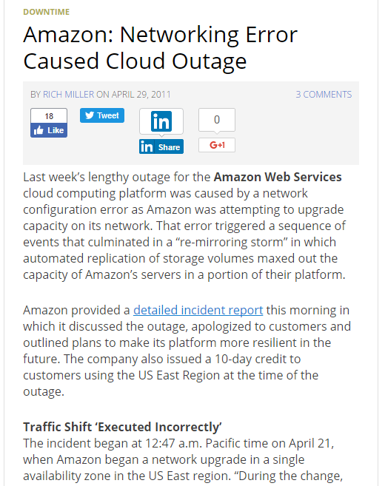
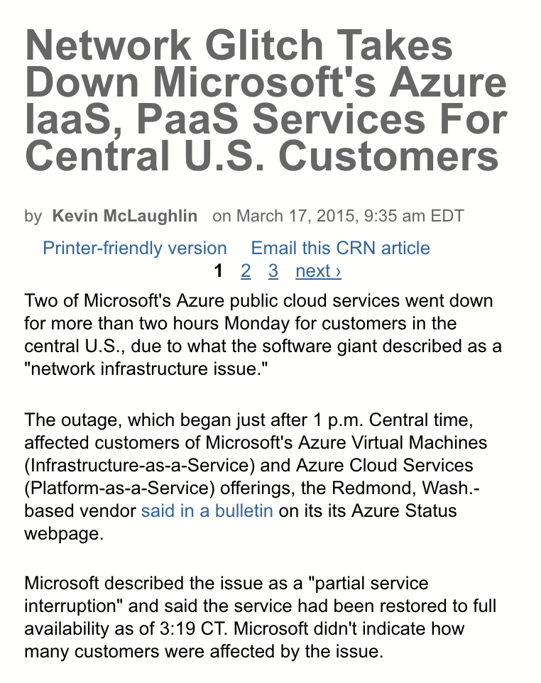
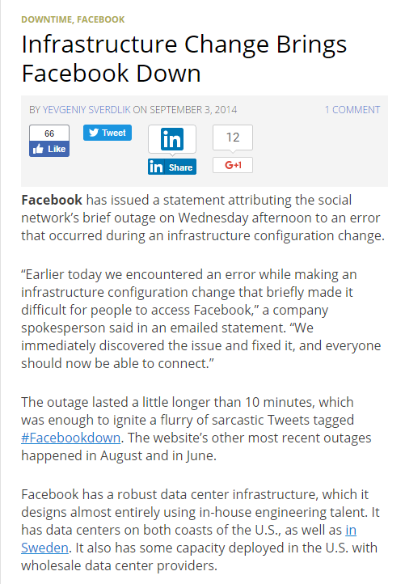
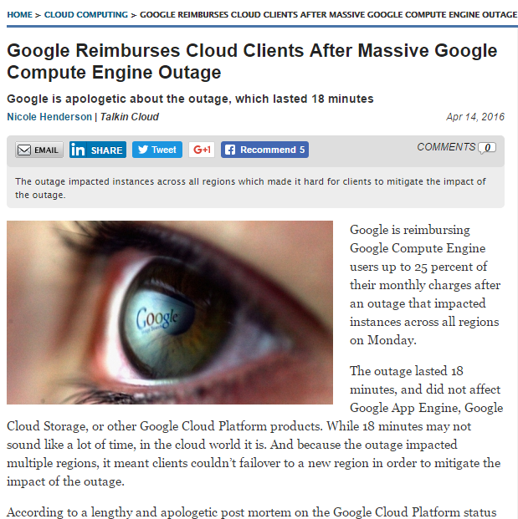
Cloud network ERA today
Poor efficiency: Average network utilization is well below 50%
Poor reliability: Outages, big and small, are common
Notes:
Reliability: Reputation damage. SLAs. Money back for customers.

Slide 8
Cloud network ERA today
Poor efficiency: Average network utilization is well below 50%
Poor reliability: Outages, big and small, are common
Poor agility: Evolving the network is onerous, time consuming
One cloud provider reported that it can take a few weeks to make even simple changes to the network.
Poor ERA impacts you too!
Notes:
This cloud provider is not MSFT. Takes time to plan, validate, and monitor the change.
Poor ERA is a problem not just for cloud providers – it impacts you too!

Slide 9
The current network programming model is a major contributor to poor network ERA
Notes:
Complex set of factors behind poor ERA but the observation behind my work is …

Slide 10
The current network programming model
Low-level and device-oriented
Manually decompose objectives into low-level, device configurations
Ensure correctness under all possible failures and workloads
70 Gbps
D
A:
AX.cost=1
AC.cost=1
…
S1
A
1
C
1
Y
X
1
1
2
2
2
E
S2
2
E
B
30 Gbps

Slide 11
The current network programming model
Low-level and device-oriented
$@!
Manually decompose objectives into low-level, device configurations
Ensure correctness under all possible failures and workloads
70 Gbps
D
A:
AX.cost=1
AC.cost=1
…
S1
A
1
C
1
Y
X
1
1
2
2
2
E
S2
2
E
B
30 Gbps

Slide 12
Hypothesis
Network-wide programming can transform network ERA
I. Abstractions to express global objectives at a high-level
II. Algorithms to correctly implement those objectives
Notes:
These abstracts and algorithms are solving the same hard problems as operators.
But can provide better ERA properties and efficiency than humans.

Slide 13
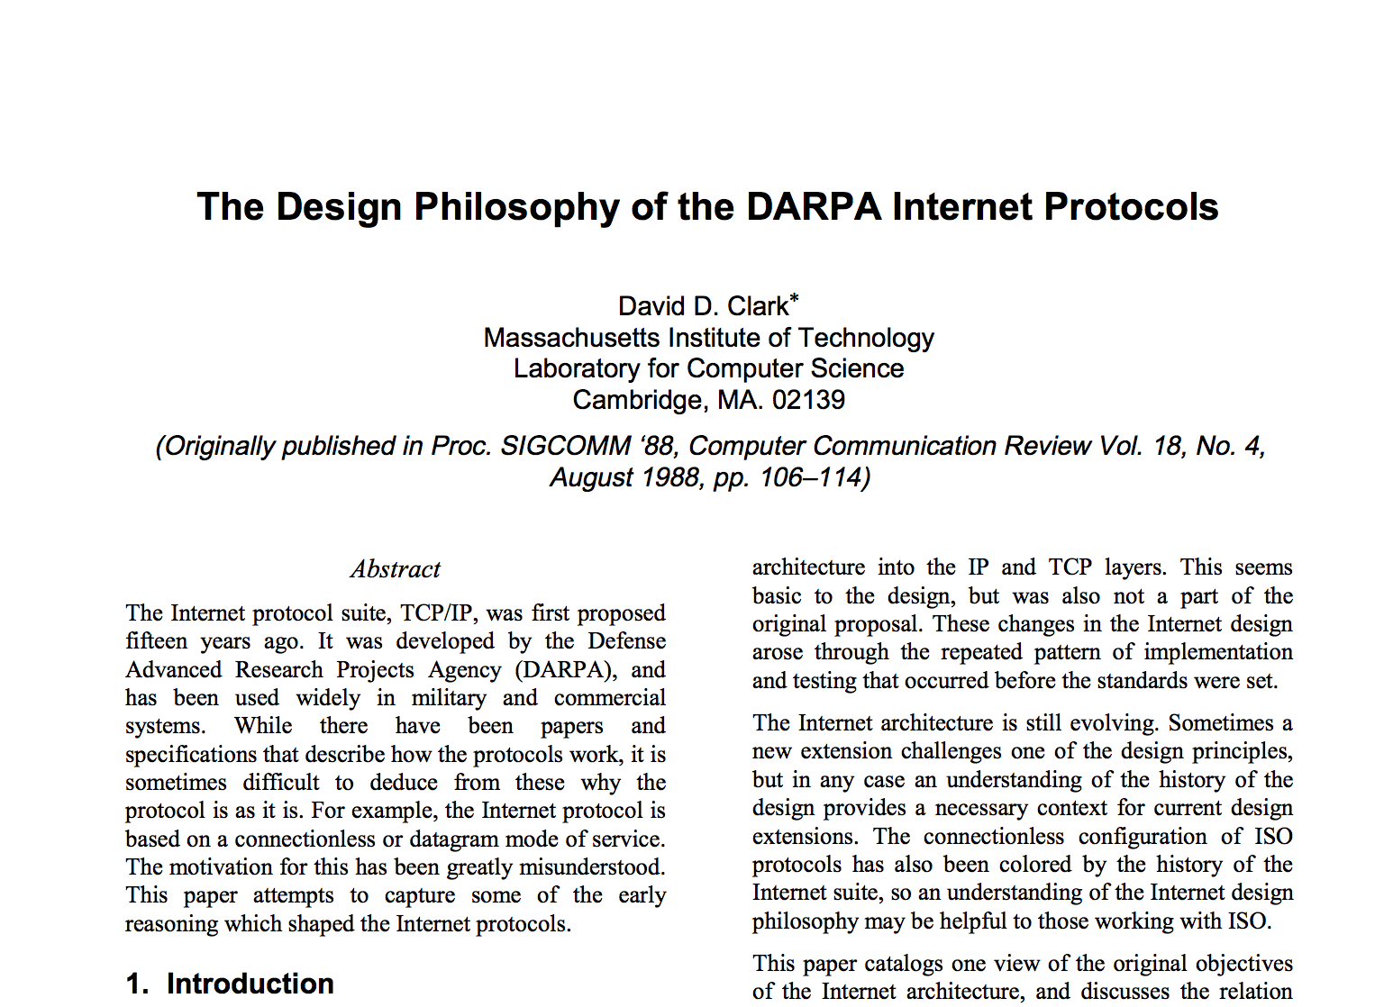
Hypothesis
Network-wide programming can transform network ERA
Network programming was not considered in the original Internet design
I. Abstractions to express global objectives at a high-level
II. Algorithms to correctly implement those objectives
Notes:
You might think its basic and should have been done. But not really.
“Network configuration” does not appear in this paper. “DARPA program” does.
Programming was not a focus before, but now it must be as we build different types of networks.

Slide 14
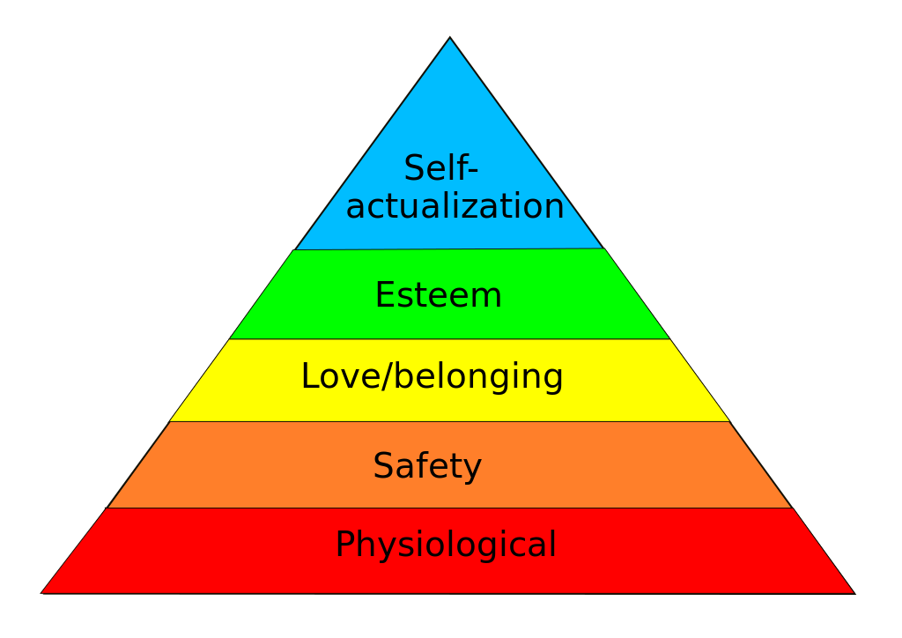
What does a network (programmer) need?
Opt- imization
Bootstrapped devices and links
Policy-compliant forwarding
Notes:
Lets ask: What does it mean for a network to be programmable?
There are any number of things that you might consider making easier to program.
One night I was taking stock of these myriad of requirements, and a picture emerged in my head. It looked this this.

Slide 15
Network programming systems
Opt- imization
Bootstrapped devices and links
Policy-compliant forwarding
Network programming research is dominated by policy-compliant forwarding for centralized control planes
Notes:
Statesman allows operators to declaratively express different concerns about their devices, such as the desired software version, which interfaces are on, monitoring and logging, etc. It then safely composes these concerns using an approach inspired by git.

Slide 16
Network programming systems
Opt- imization
Bootstrapped devices and links
Policy-compliant forwarding
SWAN [SIGCOMM 13, 14a, 14b] Enable the network to carry 50-80% more load
Propane [SIGCOMM 16, PLDI 17]
High-level programming for distributed control planes
Statesman [SIGCOMM 14c]
Declarative, safe composition of multiple concerns
Notes:
Statesman allows operators to declaratively express different concerns about their devices, such as the desired software version, which interfaces are on, monitoring and logging, etc. It then safely composes these concerns using an approach inspired by git.

Slide 17
Opt- imization
SWAN [SIGCOMM 13, 14a, 14b], Footprint [NSDI 16] Enable the network to carry 50-80% more load
with Chi-Yao Hong, Xin Jin, Harry Liu, Vijay Gill, Srikanth Kandula, Mohan Nanduri, Roger Wattenhofer, Ming Zhang
Notes:
Work led by Chi-Yao and Harry.

Slide 18
Inter-DC WAN: A critical, expensive resource
Dublin
Seattle
New York
Seoul
Barcelona
Los Angeles
Miami
Hong Kong
But it is highly inefficient and inflexible!
Notes:
Services need inter-DC WAN for performance and reliability.
100s of Gbps capacity over long distances.
Costs 100s of millions of dollars amortized annually.

Slide 19
Inefficiency of the inter-DC WAN
1
0.8
0.6
0.4
0.2
0
Average utilization = 46%
Normalized throughput
0 | 4 | 8 | 12 | 16 | 20 | 24
Hours of the day
Normalized traffic on a busy link between data centers

Slide 20
Root cause: Service-level allocations
Operators configure individual services with maximum sending rate
 | S1 | S2 | S3 | …..
SEA → NYC (80) | 10 | 15 | 5 | ….
SEA → CHI (100) | 20 | 20 | 10 | ….
……
Not efficient: The combined maximum is uncommon
Not reliable: Load can exceed capacity when failures occur
Not agile: Must change all allocations to add services or network links
Notes:
Coarse way to avoid congestion and implement fairness and priorities

Slide 21
Network-wide programming can increase ERA
1
0.8
0.6
0.4
0.2
0
Service 1
Priority: Bg
Weight: 1
Service 2
Priority: Bg
Weight: 2
Service 3
Priority: Non-bg
Weight: 1
……
Average utilization = 46%
1
0.8
0.6
0.4
0.2
0
1
0.8
0.6
0.4
0.2
0
Notes:
If the system knows the service priorities, it can modulate service sending rates appropriately.

Slide 22
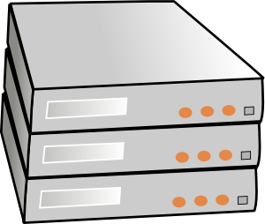
SWAN
Service 1
Priority: Bg
Weight: 1
…..
Controller
1
1
Traffic demand →
← Topology
2
Service allocations
Network configuration
3
3
WAN
Services
[Achieving high utilization with software-driven WAN, SIGCOMM 13]

Slide 23
Challenges in developing SWAN
Computational scalability
Approximation algorithm with provable bounds
Limited switch memory
Maintain the “working set” in memory
Congestion due to failures
Forward fault correction
Congestion due to updates
Congestion-free updates
Notes:
Networks do not run like that, so had to solve many practical and conceptual challenges.
Scalability challenge: hundreds of services on a global network. Approximation algorithm.
Switch memory challenge solved by keeping the “working set” in memory.
Focus on these two challenges because they are unique to networks.

Slide 24
Challenge: Congestion during network updates
Link capacity: 10
Flow size: 6.6
Notes:
Want to go from left to right, perhaps to make room for a new flow on link R2-R4.

Slide 25
Solution: Congestion-free update plans
Link capacity: 10
Flow size: 6.6

Slide 26
Computing congestion-free update plans
Leave scratch capacity $s$ on each link
Guarantees a plan with at most $\left\lceil \frac{1}{s}\right\rceil −1$ steps
Find a plan with minimum number of steps using an LP
Search for a feasible plan with 1, 2, …. max steps
Use scratch capacity for background traffic
Bound its experienced congestion
Notes:
Does an update plan always exist? How to find it? How long can it be?

Slide 27
Minimal dependencies for a consistency property
 | None | Self | Downstream subset | Downstream all | Global
Eventual consistency | Always guaranteed
Blackhole freedom | Impossible | Add before remove
Loop freedom | Impossible |  | Rule dependency forest | Rule dependency tree
Packet coherence | Impossible |  |  | Flow version numbers | Global version numbers
Congestion freedom | Impossible |  |  |  | Staged partial moves
[On consistent updates in software-defined networks, HotNets 2013]
Notes:
Dependencies capture ease of maintenance.
These are results without memory limits.
Not a solved problem yet:
- the table is qualitative
- combinations of properties missing
Memory limits complicate matters

Slide 28
Efficiency improvement with SWAN
1
0.8
0.6
0.4
0.2
0
Throughput
(relative to optimal)
SWAN
No SWAN
SWAN
SWAN carries 60% more traffic and comes close to optimal
Notes:
Data-driven simulations using traffic and topology of an inter-DC WAN

Slide 29
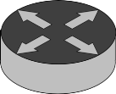
Deploying SWAN
Before
Partial deployment
Full deployment

Slide 30
Networking programming systems
Opt- imization
Bootstrapped devices and links
Policy-compliant forwarding
SWAN [SIGCOMM 13, 14a, 14b] Enable the network to carry 50-80% more load
Propane [SIGCOMM 16, PLDI 17]
High-level programming for distributed control planes
Statesman [SIGCOMM 14c]
Declarative, safe composition of multiple concerns

Slide 31
Policy-compliant forwarding
Propane [SIGCOMM 16, PLDI 17]
High-level programming for distributed control planes
with Ryan Beckett, Todd Millstein, Jitu Padhye, David Walker

Slide 32
A primer on BGP (border gateway protocol)
Ubiquitous protocol for policy routing
E
C selects one route based on its preference policy
P [E…] (tags)
P
A
C
D
P [CD] (tags)
P [D] (tags)
Data flows in the opposite direction to BGP messages
C accepts the route based on its import policy
D offers a path to C based on its export policy
Notes:
The Internet runs on BGP

Slide 33
The hazards of device-level programming
→tag “X”
→block “X”
X
←block “Y”
←tag “Y”
Y
A
D
LP=99
LP=99
B
C
LP=99
LP=101
filter 16.4.0.0/16
filter 16.4.0.0/16
Z
Policy
No transit between X,Y
Prefer C > B > {X,Y}
Use Z only for 16.4.0.0/16
Poor ERA
Difficult and time consuming to implement policies
Error prone

Slide 34
Propane
Today
BGP configs
0,0
1,1
0,1
2,1
Policy in the Propane language
Propane Compiler
Enables network-wide programming for existing networks
[Don’t mind the gap: Bridging network-level objectives and device-level configurations, SIGCOMM 16.]
Notes:
New high-level language, similar in spirit to many SDN languages
A couple of key differences
The mechanisms for achieving inter domain routing and SDN are non-existent

Slide 35
The Propane policy language
→tag “X”
→block “X”
X
←block “Y”
←tag “Y”
Y
A
D
LP=99
LP=99
B
C
LP=100
LP=101
filter 16.4.0.0/16
filter 16.4.0.0/16
Z
Policy
No transit between X, Y
Prefer C > B > {X,Y}
Use Z only for 16.4.0.0/16
define notransit = {true => not transit({X, Y})}
define preference = {true => exit (C >> B >> {X, Y})}
define ownership = {16.4.0.0/16 => end(Z)}
define main = notransit and preference and ownership

Slide 36
Compilation
Challenges
Semantic gap between BGP and the Propane language
Ensuring proactive policy compliance for all possible failures
BGP Configs
Policy

Slide 37
Compilation
Challenges
Semantic gap between BGP and the Propane language
Ensuring proactive policy compliance for all possible failures
BGP Configs
Policy
0,0
XAB
(Σ*)Y
0
1
2
1,1
0,1
0
1
2,1
Regular IR
Reverse
automata
Product
graph

Slide 38
Propane on real networks
Data center
Wide area network
31 lines of Propane
9 mins for 1400 routers
43 lines of Propane
3 mins for 200 routers
Human designed configurations are O(10,000) lines!
Notes:
Policies translated from English documents
Recent work: make it even faster and evolution friendly.

Slide 39
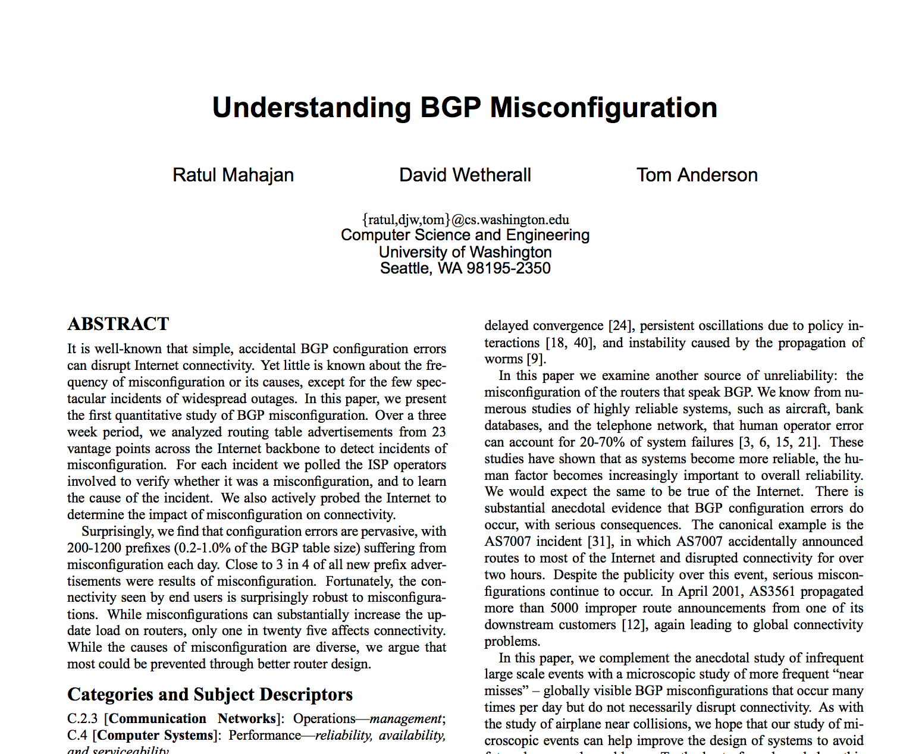
Hidden agenda behind Propane
[SIGCOMM 02]
I. Monitoring and diagnosis
Not proactive
II. Analysis and verification
Correct design is still onerous
III. Synthesis from high-level policy
Notes:
Third time is the charm.

Slide 40
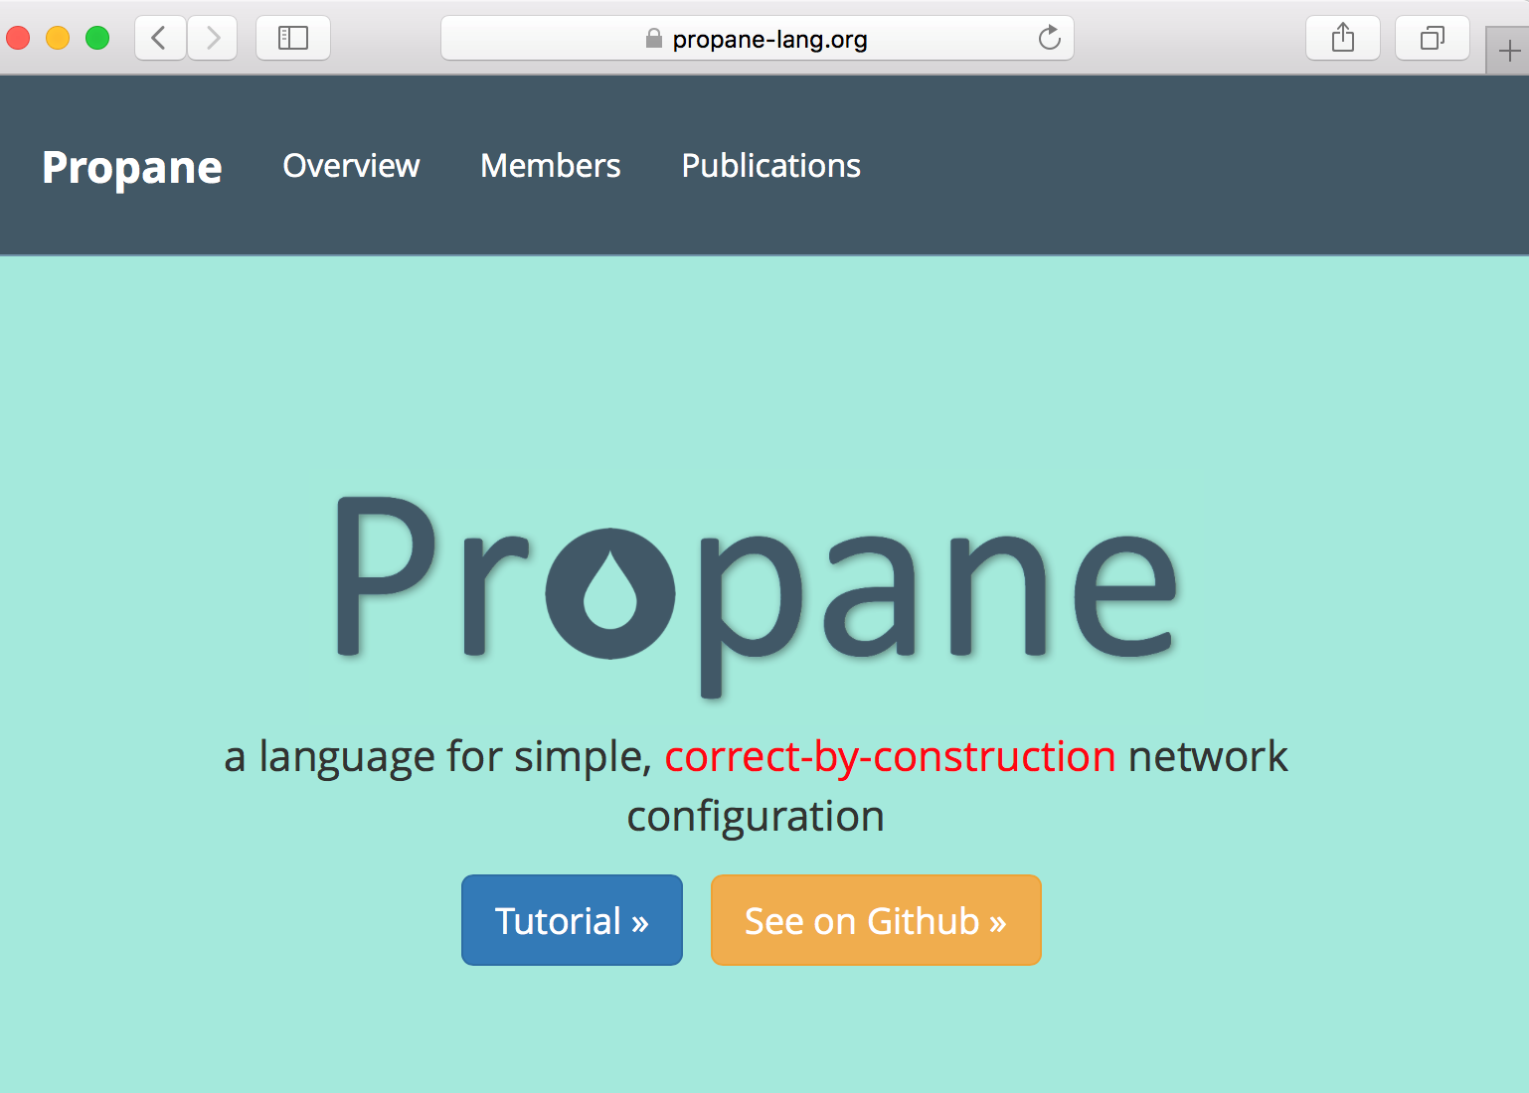
Evolving based on feedback from operators and researchers
Templates, evolution friendliness [PLDI 17]
Fault tolerance
Aggregation safety
https://www.propane-lang.org
Notes:
Our vision with Propane is to change not only cloud networks but all networks since BGP is a common substrate.
We are building infrastructure that any network operator can use.

Slide 41
Networking programming systems
Opt- imization
Bootstrapped devices and links
Policy-compliant forwarding
SWAN [SIGCOMM 13, 14a, 14b] Enable the network to carry 50-80% more load
Propane [SIGCOMM 16, PLDI 17]
High-level programming for distributed control planes
Statesman [SIGCOMM 14c]
Declarative, safe composition of multiple concerns

Slide 42
Bootstrapped devices and links
Statesman [SIGCOMM 14c]
Declarative, safe composition of multiple concerns
with Peng Sun, Jennifer Rexford, Lihua Yuan, Ming Zhang, Ahsan Arefin

Slide 43
Past: Management “apps” interacted with devices
Link corruption mitigation
Switch upgrade
Elastic scaling
Poor ERA
Conflicts among apps
Hard to guarantee SLAs
Hard to develop apps

Slide 44
Anatomy of a management app
Link corruption mitigation
Switch upgrade
Elastic scaling
App logic
App logic
App logic
Monitor
Update
Monitor
Update
Monitor
Update

Slide 45
Statesman
App logic
App logic
App logic
Power on/off
Firmware version
Link state
Tunnels
…..
Network state database
Network state
Monitor
Update
[A network-state management service, SIGCOMM 14]

Slide 46
Statesman
App logic
App logic
App logic
Proposed state
Observed state
Proposed state
Target state
Proposed state
Monitor
Update

Slide 47
Networking programming systems
Opt- imization
Bootstrapped devices and links
Policy-compliant forwarding
SWAN [SIGCOMM 13, 14a, 14b] Enable the network to carry 50-80% more load
Propane [SIGCOMM 16, PLDI 17]
High-level programming for distributed control planes
Statesman [SIGCOMM 14c]
Declarative, safe composition of multiple concerns

Slide 48
Unlocking the next level of ERA
Rethink hardware as well as layering boundaries
Notes:
While network-wide programming has transformed network ERA, the quest for ERA does not end with it. Where will the next level of ERA come from?
Unlocking the next level of ERA will stem from rethinking hardware on which the cloud networks run as well as layering boundaries boundaries.
I say that because bit by bit, cloud providers have re-engineered and optimized the software components within each layer of the stack.

Slide 49
Unlocking the next level of ERA
Rethink hardware as well as layering boundaries
Example 1. Wireless-inspired physical layer
Little qualitative change in the optics-based physical layer
Rigid and over-engineered [OFC 16, NSDI 17]
Techniques from the RF world can boost the flexibility and efficiency of the optical links
Dynamic rate adaptation, full duplex, multicast, …
Notes:
While much has changed, the optics-based has not.

Slide 50
Unlocking the next level of ERA
Rethink hardware as well as layering boundaries
Example 2: Reconfigurable hardware
On the horizon: ROADMs in the WAN, FPGA NICs in servers, disaggregated servers, programmable switches, ….
Need new abstractions and even new theories

Slide 51
Unlocking the next level of ERA
Azure SmartNIC
Rethink hardware as well as layering boundaries
Blade
FPGA can enable many functions
BYO IP, topology, appliance
Crypto
QoS
Storage acceleration
…..
Combines the agility of software and efficiency of hardware
Example 2. Reconfigurable hardware
CPU
On the horizon: ROADMs in the WAN, FPGA NICs in servers, disaggregated servers, programmable switch chips, ….
SmartNIC
NIC
ASIC
FPGA
Need new abstractions and even new theories
ToR

Slide 52
Unlocking the next level of ERA
ROADMs and “shapeshifting” graphs
Rethink hardware as well as layering boundaries
SEA
NYC
Example 2. Reconfigurable hardware
Physical topology
Graph 3
On the horizon: ROADMs in the WAN, FPGA NICs in servers, disaggregated servers, programmable switch chips, ….
SFO
MIA
Need new abstractions and even new theories
Graph 1
Graph 2
Notes:
ROADMs route wavelengths. To make a connection, the red should connect to red, and no two colors can traverse the same fiber.
A lot of theory on which networking is based deals with one of these graphs. We don’t have a viable theory for these shapeshifting graphs.
The underlying topology is different from standard graphs. We need to reconsider what basic concepts like max flow and min cut mean for the topology, and how to derive graphs with desired properties.

Slide 53
Unlocking the next level of ERA
Rethink hardware as well as layering boundaries
Example 2. Reconfigurable hardware
On the horizon: ROADMs in the WAN, FPGA NICs in servers, disaggregated servers, programmable switch chips, ….
Need new abstractions and even new theories
Application-driven configuration for key workloads, e.g., ML, IoT messages, and load balancers

Slide 54
Unlocking the next level of ERA
Rethink hardware as well as layering boundaries
Requires collaboration that is inter-disciplinary and straddles academia and industry
Notes:
1/ The path to success lies in inter-disciplinary collaboration. The set of problems cut across expertise boundaries, as my examples showed. Networking and systems people cannot do it alone.
2/ It will also need academia industry collaboration. The academia needs industry to understand workloads and plausible design points. The industry needs academia because the next set of problems they want to solve are broader and deeper.

Slide 55
Summary
Cloud networks are characterized by an extreme focus on ERA
Driven by scale and workload dynamics
Network-wide programming can transform network ERA
Should take a broad view of network programming
Next frontier: Rethink hardware and layering boundaries
Need inter-disciplinary and academia-industry collaboration

